Slide 1

Multi-Modal Hate Speech Detection
Presented By
VAISHNAVI N. GHADGE
TE (Computer Engineering)
Roll No. : TCB20
Under the guidance of
Prof. Deepti Chaudhari
Department of Computer Engineering
A.Y. 2025-26
Hope Foundation’s
International Institute of Information Technology, Hinjewadi, Pune-411057

Slide 2
Contents
Introduction
Motivation
Literature Survey
Summary/Findings of Literature Survey
Objectives of Exisitng System
Architecture of the Existing Systems
Algorithm
Problem Statement
Aim and Objectives
Conclusion
References
Department of Computer Engineering, International Institute of Information Technology, Hinjawadi, Pune-411057

Slide 3
Introduction
Hate speech on social media is becoming more complex and harder to detect. It no longer appears only in text — it’s often hidden in memes (images with text), sarcastic videos, and even in tone of voice.
To handle this, researchers have started using multi-modal hate speech detection, which means using multiple types of data — text, images, audio and video — together to find hate more accurately.
Traditional models only look at one type of content, like text. But hate speech today is often hidden or mixed across formats. That’s why multi-modal systems are powerful — they combine all available clues to detect hate even when it’s subtle or disguised.
Finding and stopping hate speech on social media platforms like Instagram, Twitter, YouTube, etc.
Department of Computer Engineering, International Institute of Information Technology, Hinjawadi, Pune-411057

Slide 4








This technology is especially useful for platforms like YouTube, Instagram, or TikTok, where users post voice-overs, sarcastic videos, or memes. Deep learning models like CNNs (for images), LSTMs (for audio/text/video), and attention layers help build smarter systems that understand these multi-modal inputs and give better, fairer results.
#Hate speech is not just bad words in text, but also hidden in:
Voice tone
Sarcastic videos
Memes (images with text)
Videos (facial expression + voice + text)
Department of Computer Engineering, International Institute of Information Technology, Hinjawadi, Pune-411057

Slide 5
Multi-Modal
“Multi-modal” means using many types of data together
TYPE OF DATA | EXAMPLE
Text | Comments , Tweets , Captions
Image | Memes , Screenshots
Audio | Voice Tone In A Video
Video | Facial Expression , Body Language
Tools Used:-
TOOL | WHAT IT DOES
Convolutional Neural Network (CNN) | Understand Images , Video Frames
Recurrent Neural Network (RNN/LSTM) | Sequence in Text And Audio
BERT / Word2Vec | Understand Meanings of words Deeply
Attention | Tells The System What’s Most Important
Department of Computer Engineering, International Institute of Information Technology, Hinjawadi, Pune-411057

Slide 6
Motivation
Hate speech on social media is becoming more complex—no longer limited to plain text, it now hides within memes, sarcastic videos, and voiceovers. Traditional text-based systems often miss these cues, making it essential to combine text, image, and audio for more accurate detection. My interest in AI for social good and the growing impact of digital toxicity motivated me to explore this area through deep learning and real-world case studies.
Addresses Real Issues: Helps detect hate speech in modern formats like reels, memes, and audio clips—where sarcasm or imagery hides the true intent.
Academic & Personal Interest: Combines my interests in NLP, computer vision, and responsible AI to solve a meaningful, high-impact problem.
Inspired by Research: Papers like Attentive Fusion (2024) and Multi3Hate Dataset (2024) showed how multi-modal models outperform unimodal ones in detecting hate.
Department of Computer Engineering, International Institute of Information Technology, Hinjawadi, Pune-411057

Slide 7
Literature Survey
Paper No | Title Name | Methodology | Advantages | Limitations | Results | Future Scope
1 | MMFFHS (IEEE Transactions on Big Data) | Combines text (LSTM) + image features (ResNet50, DenseNet121, MobileNetV2); fused in dense layer. | Works on multimodal posts, uses transfer learning, better balance of precision & recall. | Used 10% dataset, binary only, weak in multi-class, English-only. | Fusion: Precision ~0.69, Recall ~0.70, Accuracy 70.26%; Multi-class ~79% | Full dataset, detailed categories, user/thread features, multilingual expansion.
2 | Multimodal Deep Learning for Hate Speech Detection | Combines text (BERT), audio (MFCC), and vision (ViT + BiLSTM with attention). Flexible fusion handles missing modalities. Evaluated with 5-fold cross validation on HateMM dataset. | Robust to missing modalities, scalable for real-world use, improved context capture across audio–visual–text. | Dataset relatively small (1,083 videos), biased toward some communities; random frame sampling may miss hateful segments. | Multimodal > Unimodal; BERT (79.1%), ViT (75.6%), MFCC (67.5%), Fusion (83.37%). | Expand dataset for diversity; improve temporal localization of hateful segments; real-time moderation (e.g., YouTube/TikTok).
Department of Computer Engineering, International Institute of Information Technology, Hinjawadi, Pune-411057

Slide 8
Paper No | Title Name | Methodology | Advantages | Limitations | Results | Future Scope
3 | A Deep Multimodal Neural Network for Hate Speech Detection in Dravidian Languages | Multimodal framework combining text (XLM-RoBERTa) and audio (MFCCs) features, fused and classified with machine learning & deep learning models | Works on low-resource Dravidian languages; effective fusion of text + audio; superior to traditional ML models. | Weak performance for Telugu due to small dataset, code-mixing, and dialect diversity; imbalance issues. | MMC Accuracy: 72% (Tamil), 78% (Malayalam), 37% (Telugu); outperformed LR, SVM, RF, NB, KNN. | Larger balanced datasets, better handling of dialects/code-mixing, improved multimodal fusion.
4 | Multi-modal Hate Speech Detection | Multimodal framework combining text, image, and audio; features extracted via preprocessing + ML models (SVM, RF, LR, KNN, NB, Decision Tree) with ensemble voting. | Captures cross-modal cues, robust with ensemble, higher F1 than single models. | Dataset imbalance, sarcasm/context complexity, still gap vs. human understanding. | Ensemble showed up to ~10% F1 improvement over single classifiers. | Better domain-specific pre-training, stronger context adaptation, bridging gap with human judgment.
Department of Computer Engineering, International Institute of Information Technology, Hinjawadi, Pune-411057

Slide 9
Paper No | Title Name | Methodology | Advantages | Limitations | Results | Future Scope
5 | Multimodal Zero-Shot Framework for Deepfake Hate Speech Detection in Low-Resource Languages | Multimodal text–audio framework with contrastive learning; SONAR (text) + SeamlessM4T (audio) encoders; joint embedding + triplet + BCE loss; new synthetic multilingual dataset (127k samples, 6 languages). | First deepfake hate dataset; robust cross-lingual & cross-modal; works in low-resource settings; strong zero-shot performance. | Synthetic dataset (deepfake audio, not real speech); imbalance across languages; performance varies by linguistic group. | Proposed > baselines (SentenceBERT, CNN-GRU, ASTBERT, WavLM-BERT); ~10% higher accuracy/F1 in most cases. | Expand dataset with real & varied deepfakes; improve cross-lingual transfer; extend to real-time moderation.
6 | Effective multimodal hate speech detection on Facebook hate memes. | Hybrid ResNet (images) + RoBERTa (text), with Incremental PCA (dim. reduction), SMOTE (balancing), and adversarial training for robustness. | Tackles class imbalance, enhances adversarial robustness, efficient multimodal fusion. | Struggles with sarcasm, cultural bias, nuanced context. | Outperforms baseline models (e.g., Visual-BERT, UNITER, VilBERT-CC). | Test on stronger adversarial attacks, apply to multilingual memes, expand robustness.
Department of Computer Engineering, International Institute of Information Technology, Hinjawadi, Pune-411057

Slide 10
Paper No | Title Name | Methodology | Advantages | Limitations | Results | Future Scope
7 | Multimodal Hate Speech Detection using Transformer Models | Fusion of text and image features via Transformer (RoBERTa + ResNet), with attention and balanced sampling. | Captures cross-modal cues, handles imbalance better. | Struggles with sarcasm, small dataset bias. | Accuracy ~82%, F1 improved over prior works. | Expand datasets, cultural context handling, real-time deployment.
8 | Multimodal Hate Speech Detection using Cross-Modal Fusion | Combines text (RoBERTa) + image (ResNet) via cross-modal fusion with feature reduction (PCA) and imbalance handling (SMOTE). | Better cross-modal context, handles imbalance, improved robustness. | Limited sarcasm detection, dataset bias, high compute. | Accuracy ~82%, higher F1 than baselines. | Expand datasets, handle sarcasm/irony, real-time moderation.
Department of Computer Engineering, International Institute of Information Technology, Hinjawadi, Pune-411057

Slide 11
Paper No | Title Name | Methodology | Advantages | Limitations | Results | Future Scope
9 | Multilingual Hate Speech Detection with GPT-3.5 Turbo and Baseline Models | Compared ML (SVM), DL (BiLSTM+FastText), TL (BERT/Roberta/XLM-R), and LLM (GPT-3.5 Turbo) on English, Spanish, Urdu, and joint multilingual corpora. | Strong cross-lingual generalization, robust on multilingual data. | Translation loss, small dataset, poor Urdu results, sarcasm/context issues. | GPT-3.5 Turbo scored 0.87 (EN), 0.85 (ES), 0.81 (UR), 0.88 (Joint). | Larger datasets, real multilingual code-mixing, better sarcasm/context handling.
10 | A Transformer-based Multi-task Learning Approach to Multimodal Hate Speech Detection | Multi-task learning (MTL) framework combining CLIP, UNITER, BERT across 4 meme datasets, with unimodal (CNN, BiLSTM, BERT, RoBERTa, LaBSE; VGG-16) | Strong cross-modal alignment, transfer across datasets, robustness to diverse meme styles. | High computation, still weak on sarcasm/implicit hate, dataset bias. | Up to 84.5% accuracy, 0.869 AUC-ROC, 83.7% F1 across datasets—better than SOTA. | Extend to audio, cultural/linguistic diversity, better sarcasm/context detection, larger datasets.
Department of Computer Engineering, International Institute of Information Technology, Hinjawadi, Pune-411057

Slide 12
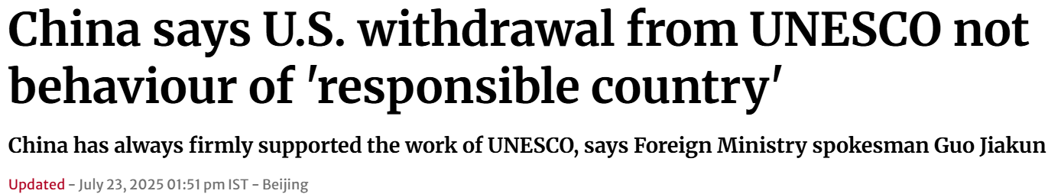
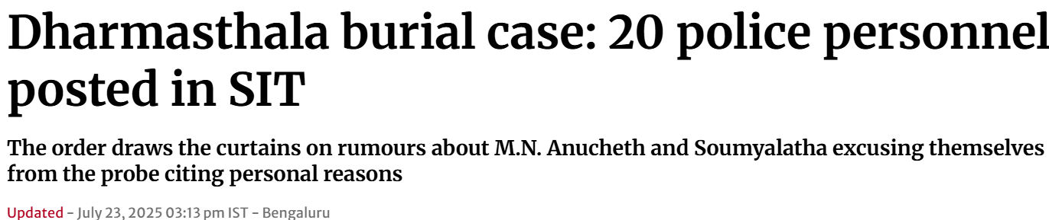
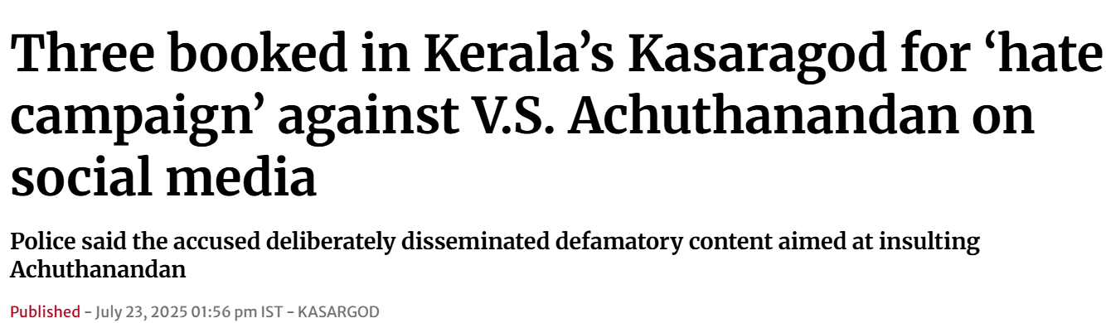
Latest News Cutouts
Department of Computer Engineering, International Institute of Information Technology, Hinjawadi, Pune-411057

Slide 13
Summary of Literature Survey
Common Trends
Multimodal > Unimodal: Text + images + audio + video give higher accuracy.
Fusion layers (attention, concatenation) enhance feature interaction.
CNNs for images, LSTMs/BERT for text are dominant choices.
Preprocessing & augmentation handle noisy, imbalanced social data.
Gaps
Lack of interpretability: few explainable AI models.
Imbalanced datasets lower F1 for minority hate classes.
Low-resource languages & code-mixed content underexplored.
Weakness against adversarial attacks & cultural slang.
Opportunities
Develop explainable multimodal models for transparent hate-speech detection.
Create balanced, multilingual datasets covering diverse media and cultures.
Enhance robustness and scalability with transfer learning and real-time video analysis.
Department of Computer Engineering, International Institute of Information Technology, Hinjawadi, Pune-411057

Slide 14
Objectives of Existing System
Detect and classify hate speech, usually from single-modality text (tweets, comments, posts).
Use machine-learning or deep-learning classifiers (SVM, RF, LR, CNN, LSTM) for prediction.
Provide basic content moderation by flagging or filtering offensive material.
Handle common text preprocessing (tokenization, stopword removal, stemming/lemmatization).
Achieve reasonable accuracy for structured text but with limited support for sarcasm, memes, or tone.
Focus mainly on accuracy and speed, often neglecting explainability and multimodal robustness.
Department of Computer Engineering, International Institute of Information Technology, Hinjawadi, Pune-411057

Slide 15
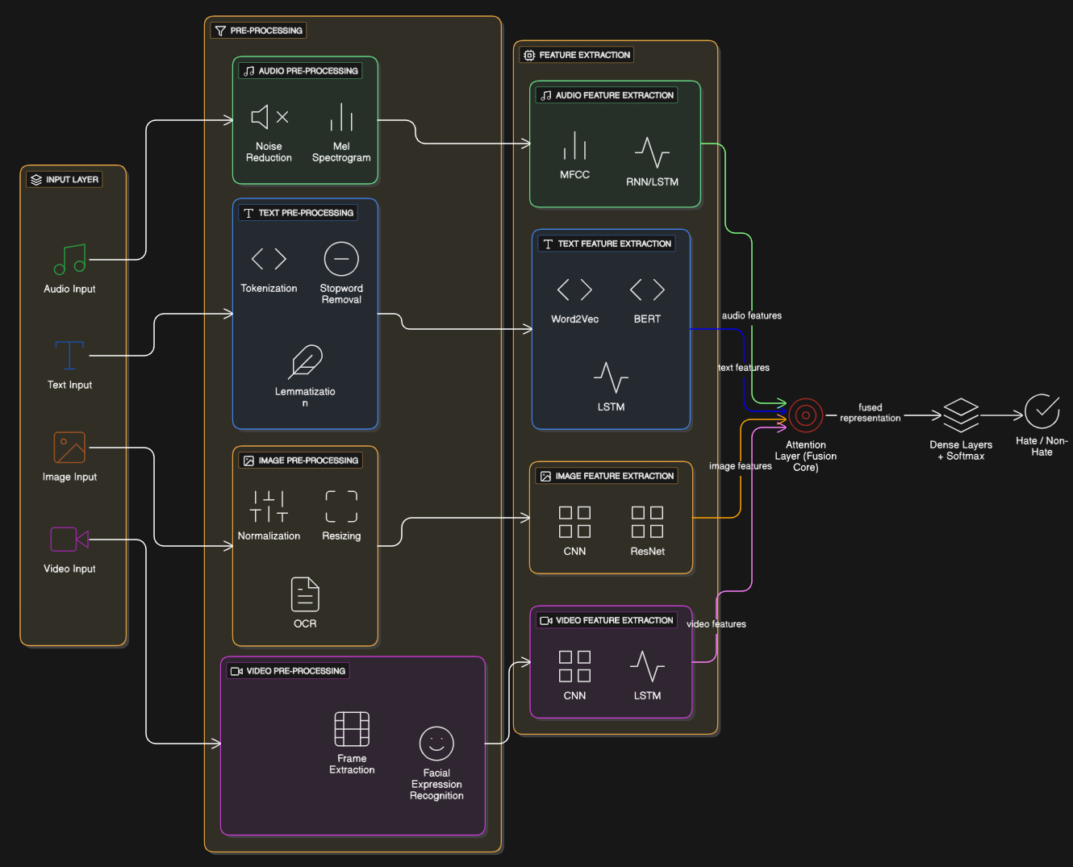
Architecture of Existing Systems
Department of Computer Engineering, International Institute of Information Technology, Hinjawadi, Pune-411057

Slide 16
Algorithm
Data Collection
Gather multimodal data from social media sources (posts, memes, audio clips, and videos).
Label samples into categories: Hate and Non-Hate.
2. Pre-processing
Text: Perform tokenization, stopword removal, and lemmatization.
Image: Normalize and resize; apply OCR for extracting embedded text.
Audio: Reduce noise and convert audio into Mel-spectrograms.
Video: Extract frames and apply facial expression recognition where required.
3. Feature Extraction
Text Features: Generate contextual embeddings using BERT or Word2Vec, followed by LSTM to preserve sequential context.
1)BERT:- Use: Text understanding (NLP).
Reads text both left-to-right and right-to-left → understands context deeply.
Ex: In the sentence “I hate you”, BERT captures the word hate in relation to you.
Better than simple word embeddings like Word2Vec.
Department of Computer Engineering, International Institute of Information Technology, Hinjawadi, Pune-411057

Slide 17
2) Word2Vec(Word to Vector):-
Use: Converts words into numerical vectors.
3) LSTM( Long short-Term Memory):-
Captures sarcasm or hate hidden in tone of voice or long sentences.
Tracks context in text/audio sequences.
Image Features: Use CNN or ResNet models to detect visual patterns and contextual cues.
1) CNN (Convolution neural network)
Use: Image & video frame analysis.
Convolution layers slide filters over input images → detect features like edges, shapes, objects.
Pooling layers reduce size → make model faster.
Fully connected layers → combine features for classification.
2) ResNet (Residual Network)
Type: Advanced CNN architecture.
Audio Features: Extract MFCC-based features and process them with RNN/LSTM for temporal sequence modeling.
Department of Computer Engineering, International Institute of Information Technology, Hinjawadi, Pune-411057

Slide 18
MFCC(Mel Frequency Cepstral Coefficients)
Use: Audio processing.
Converts audio signal into features that represent tone, pitch, frequency.
2) RNN /LSTM (Recurrent Neural Network/long-short Term Memory)
How it Works: Processes data step by step, carrying forward a hidden state (memory) from previous inputs → understands context across sequences like text or audio.
    Why used: Useful for detecting temporal patterns in sentences (sarcasm, context) or audio (tone, stress).
Video Features: Use CNN or LSTM models to detect visual patterns and contextual cues.
1) CNN (Convolution neural network)
Use: Image & video frame analysis.
Convolution layers slide filters over input images → detect features like edges, shapes, objects.
Pooling layers reduce size → make model faster.
Fully connected layers → combine features for classification.
2) LSTM(long-short Term Memory)
Captures sarcasm or hate hidden in tone of voice or long sentences.
Tracks context in text/audio sequences.
Department of Computer Engineering, International Institute of Information Technology, Hinjawadi, Pune-411057

Slide 19
4. Feature Fusion
Align extracted features across modalities.
Apply attention-based fusion to prioritize the most informative modality for each sample.
Concatenate weighted features into a unified representation.
5. Classification
Pass fused features through fully connected layers.
a) Dense Layer (Fully Connected Layer)
Takes the fused features (from text, image, audio, video) and learns complex combinations of them.
Example: A meme with the word “dog” + an offensive picture. Dense layers combine both signals to realize it’s hate speech.
Mathematically:
y=W⋅x+b
Where ,
W are weights, x is input features, and b is bias.
Apply softmax activation to generate final predictions:
  Class 1: Hate Speech
  Class 0: Non-Hate Speech
Department of Computer Engineering, International Institute of Information Technology, Hinjawadi, Pune-411057

Slide 20
b)Softmax Classifier
A mathematical function that converts raw scores into probabilities between 0 and 1.
For binary classification (Hate vs Non-Hate):
Output → [0.85, 0.15] (means 85% chance hate, 15% chance not hate).
For multi-class classification (Racist, Sexist, Offensive, Non-Hate, etc.):
6. Evaluation
Assess performance using metrics such as accuracy, precision, recall, and F1-score.
1)Accurancy:- (TP+TN)/(TP+TN+FP+FN)
2) Precision :- TP/(TP+FP)
3) Recall:- TP/(TP+FN)
4) F1 –score:- 2*((Precision * recall)/(precision + recall))
Where, TP = True Positive
TN = True Negative
FP = False Positive
FT = False True
Compare multimodal results with unimodal baselines.
Department of Computer Engineering, International Institute of Information Technology, Hinjawadi, Pune-411057

Slide 21
Problem Statement (Proposed System)
Current hate speech detection models focus mainly on text, struggling with memes, sarcasm, audio tones, and other multimodal cues.
Why It Matters
High false positives/negative
in real-world moderation.
Limited support for code-
mixed and low-resource
languages.
Poor interpretability, making
decisions hard to justify.
Findings from Literature
Studies report up to 20–30% performance drop on minority classes (e.g -telugu)
Surveys show users encounter hateful memes and videos that text-only systems fail to flag.
Robust, explainable multimodal frameworks are needed for effective and fair moderation.
Department of Computer Engineering, International Institute of Information Technology, Hinjawadi, Pune-411057

Slide 22
Aim and Objectives (Proposed System)
Aim: To develop a robust multi-modal hate speech detection framework that integrates text, images, audio, and video using deep learning for accurate and explainable detection on social media platforms.
Objectives:
- To analyze existing unimodal and multimodal approaches for hate speech detection and identify their limitations.
- To evaluate the effectiveness of advanced deep learning models (CNN, LSTM, BERT, Attention) in handling multi-modal data.
- To design a hybrid framework that fuses features from text, image, and audio/video for improved accuracy and robustness.
- To implement and validate the proposed system on benchmark datasets, measuring accuracy, scalability, and interpretability.
Department of Computer Engineering, International Institute of Information Technology, Hinjawadi, Pune-411057

Slide 23
Conclusion
Findings:
Multi-modal detection (text + image + audio + video) outperforms unimodal systems with higher accuracy, robustness, and interpretability.
Importance:
Essential to capture hidden hate in memes, sarcastic videos, and voice tones → enables safer, fairer social platforms.
Future Work:
Build larger & balanced datasets (incl. low-resource languages).
Improve explainability (e.g., SHAP, Grad-CAM).
Real-time deployment for social media moderation.
Adapt models across cultures & domains.
Department of Computer Engineering, International Institute of Information Technology, Hinjawadi, Pune-411057

Slide 24
References
  Prabhu, R., Seethalakshmi, V. A comprehensive framework for multi-modal hate speech detection in social media using deep learning. Sci Rep 15, (2025). https://doi.org/10.1038/s41598-025-94069-z
  Rishabh Ranjan, Multimodal Zero-Shot Framework for Deepfake Hate Speech Detection in Low-Resource Languages. Submitted on 10 Jun (2025). https://doi.org/10.48550/arXiv.2506.08372
  https://doi.org/10.48550/arXiv.2506.08372
  Emmanuel Ludivin Tchuindjang Tchokote, Elie Fute Tagne,
  Effective multimodal hate speech detection on Facebook hate memes dataset using incremental PCA, SMOTE, and adversarial learning 20 June (2025). https://doi.org/10.1016/j.mlwa.2025.100647
Department of Computer Engineering, International Institute of Information Technology, Hinjawadi, Pune-411057

Slide 25
4) P. K. Roy, "MMFFHS: Multi-Modal Feature Fusion for Hate Speech Detection on Social Media," in IEEE Transactions on Big Data, vol. 11, no. 3, pp. 1247-1258, June 2025,
https://doi.org/10.1109/TBDATA.2024.3445372.
5) Vydana, Sai Aakash. "Multimodal Deep Learning for Hate Speech Detection.“2025
https://cse.buffalo.edu/tech-reports/2025-15.pdf
6) Shraddha Chauhan and AbhinavKumar 2025.A Deep Multimodal Neural Network for Hate Speech Detection in Dravidian Languages.
https://aclanthology.org/2025.dravidianlangtech-1.41/
7) Chandna, Disha and Srivastava, Banshika and Agarwal Multi-Modal Hate Speech Detection(24 March, 2025)
http://dx.doi.org/10.2139/ssrn.5190869
Department of Computer Engineering, International Institute of Information Technology, Hinjawadi, Pune-411057

Slide 26
8) Saddozai FK, Badri SK, Alghazzawi D, Khattak A, Asghar MZ. 2025. Multimodal hate speech detection: a novel deep learning framework for multilingual text and images https://doi.org/10.7717/peerj-cs.2801
9) ELT Tchokote, EF Tagne, Effective multimodal hate speech detection on Facebook hate memes dataset using incremental PCA, SMOTE, and advere learning(June 2025) https://doi.org/10.1016/j.mlwa.2025.100647
10) Usman, M.; Ahmad, M.; Sidorov, G.; Gelbukh, I.; Tellez, R.Q. A Large Language Model-Based Approach for Multilingual Hate Speech Detection on Social Media Computers 2025, 14, 279. https://doi.org/10.3390/computers14070279
Department of Computer Engineering, International Institute of Information Technology, Hinjawadi, Pune-411057

Slide 27
Queries ?
YOU HAVE ANY QUESTIONS ASK FREELY!!
Department of Computer Engineering, International Institute of Information Technology, Hinjawadi, Pune-411057

Slide 28
Thank You
Department of Computer Engineering, International Institute of Information Technology, Hinjawadi, Pune-411057

